Slide 1
Background
Modest upbringing. Born in Hope, Arkansas.
Obsessed with politics throughout schooling
Shook hands with President Kennedy – ambition.
Georgetown University, Rhodes Scholar at Oxford.
Received permission to skip the Vietnam War from the local draft board to go to Oxford*
Participated in anti-war demonstrations in England.
Marries Hillary Rodham (Clinton), fails to win House election, but becomes rising star in Arkansas.
Wins governor's race at age 32, loses next term, practices law, runs again and wins.
Moderate democrat: reforms welfare, education and promotes affirmative action.
Professional politician.

Slide 2
1992 Election
Infidelity, the Vietnam War draft, “I didn’t inhale” and “boxers or briefs”.
President Bush – checkout scanner
H. Ross Perot – economic focus.
Issues: Bush raising taxes, deficit
“It’s the economy, stupid.”
Electoral College map.
SNL

Slide 3
Taxes
Omnibus Budget Reconciliation Act of 1993
2 new income brackets: 36% and 39.6%
Passed 218-216 in House
Passed 51-50 in the Senate
Economy surged due to something called e-commerce, computers and home construction.
Federal deficit of $200B+ turned into a SURPLUS of $100B+ by 1999. Whaaaa?
Projected surplus of $1.5T through first decade of 21st century.
Job growth? 20,000,000 new jobs. Whoa.

Slide 4
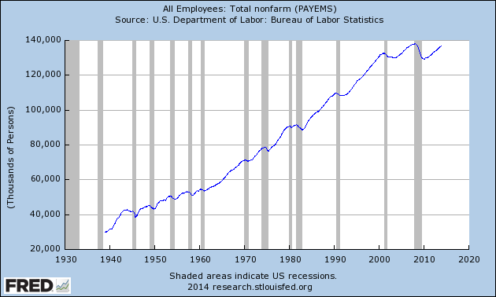

Slide 5
Politics
NAFTA – North American Free Trade Agreement. No excise taxes on goods traded between Canada, US, and Mexico = free trade.
R - Increase profit/trade for businesses between the countries.
D - Relocate businesses to cheaper wage countries.
Clinton Health Plan of 1994: health insurance card that guarantees a choice of plans from insurance companies. Obamacare
Labled as “Hillarycare”, and sunk by blunders in rolling out the plan.
“Harry and Louise”

Slide 6
Continued…
1994 midterm election. “Hillarycare” causes massive backlash against “big government” notions.
House: 1992-94 (D258-176)
House: 1994-96 (R230-204) 54 seat swing
Senate: 1992-94 (D53-47)
Senate 1994-96 (R53-47) 6 seat swing
2010 Election

Slide 7
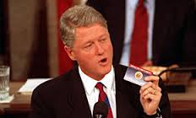

Slide 8
Other Acts
Welfare reform: Proof of searching for a job a requirement for unemployment insurance
Limited time to collect.
“Don’t ask, don’t tell.”
Scandals
Whitewater
Travelgate
Paula Jones
Monica Lewinsky

Slide 9
Impeachment
2 articles of impeachment
Perjury (lied about having an affair under oath)
Obstruction of justice (persuaded witnesses to not testify about the Lewinsky affair)
Trial in the Senate (January 1999)
Article I: acquitted 45R-55(45D+10R)
Article II: acquitted 50R-50 (45D+5R)
Clinton approval rating???? 70% Why?

Slide 10
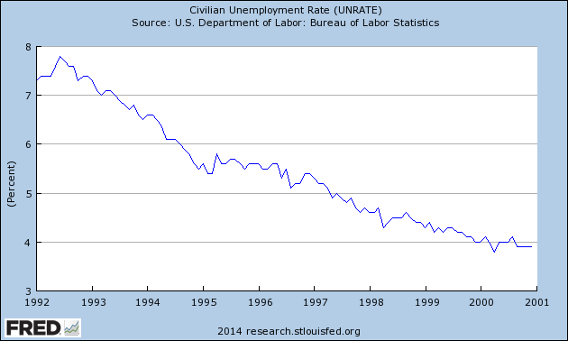
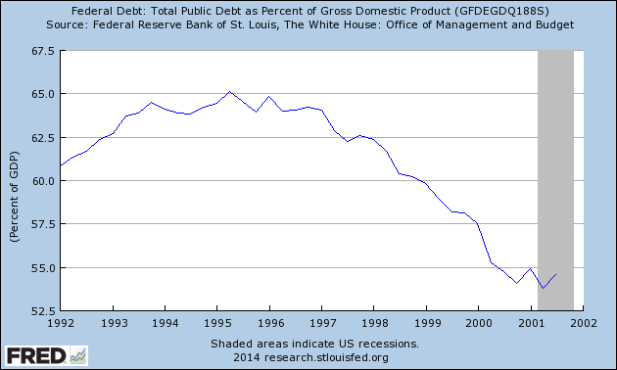
“It’s the economy, stupid!”

Slide 11
Foreign Affairs
Somalia – Relief of famine turned into a hunt for warlords. Blackhawk Down
Haiti – Restore Jean Bertrand-Aristide to elected president (overthrown in coup)
Rwanda Genocide – 500,000-1,000,000 people killed in “ethnic cleansing”. US did nothing. “Hotel Rwanda”
Bombing of Serbian army units ethnic cleansing of Albanians in Kosovo.

